Slide 1

Green Skilling, Sustainability & AI (SDG 17)
Student Details
• Name: Nija Mavani
• Enrollment No.: 230760116083
• Stream: Information Technology (IT)
• College: SSASIT, Surat
•
• Presentation covers sustainable data centres, ecological footprint, carbon calculators, En-ROADS climate simulation, NANDO AI Smart Bins, SCGJ Green Jobs, AI for sustainability, and AI-based capstone project ideas.
Add Screenshots Here

Slide 2
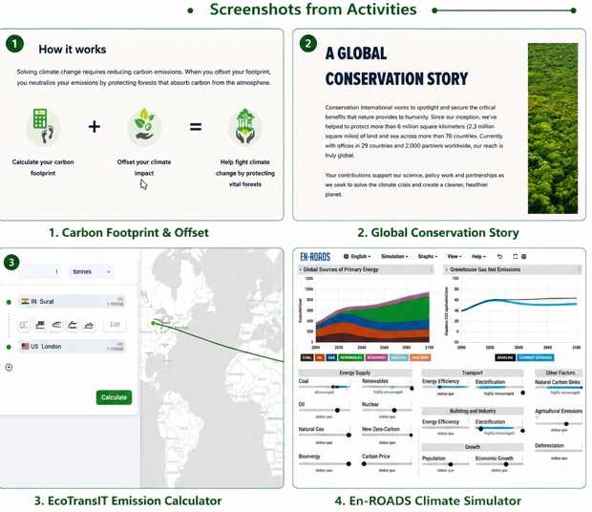
What I Learned from the Given Resources
Key Learnings
• The Data Centre documentary explained that modern AI, cloud computing and online services depend on large data centres that consume huge amounts of electricity and water for cooling.
• Ecological Footprint Calculator helped me understand how food, transport and energy use affect Earth's natural resources.
• Carbon Calculators (Conservation International and e-AMRIT) showed how everyday activities produce CO₂ emissions and suggested ways to reduce them.
• EcoTransIT estimates emissions from road, rail, air and sea transport, helping businesses choose greener logistics.
• En-ROADS demonstrated that combining renewable energy, energy efficiency and strong climate policies can significantly reduce global warming.
Add Screenshots Here

Slide 3
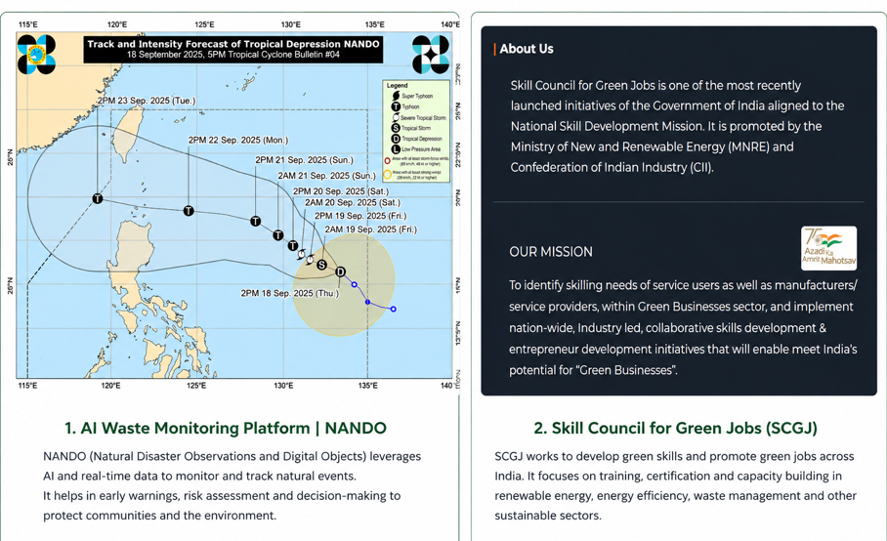
Green Skilling, AI & Sustainability
Important Concepts
• Green Skilling means learning skills that help protect the environment through renewable energy, recycling and sustainable industries.
• Sustainability focuses on meeting today's needs while protecting resources for future generations.
• NANDO AI Smart Bins use artificial intelligence to recognize waste and improve recycling efficiency.
• SCGJ (Skill Council for Green Jobs) provides training for careers in solar energy, electric vehicles and other green sectors.
• AI supports pollution monitoring, climate prediction and energy optimization, but AI infrastructure also consumes electricity and creates e-waste.
Add Screenshots Here

Slide 4
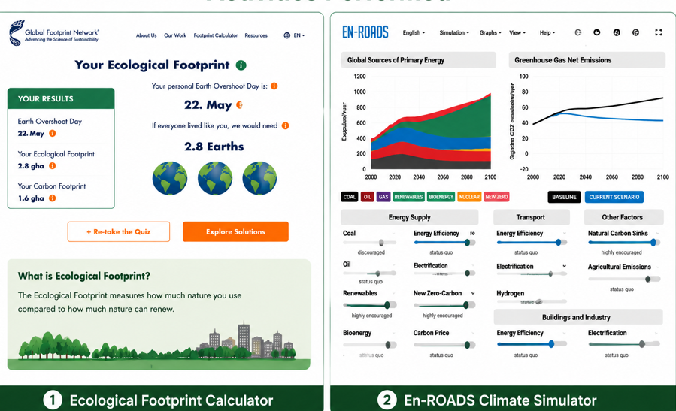
Activities Performed
Websites & Tools Explored
• Completed the Ecological Footprint Calculator.
• Explored Conservation International Carbon Calculator.
• Estimated transport emissions using EcoTransIT.
• Experimented with different scenarios in the En-ROADS Climate Simulator.
• Visited NANDO AI Smart Bins, Gen.E Media and SCGJ websites.
• Used the e-AMRIT CO₂ Calculator to compare vehicle emissions.
Add Screenshots Here

Slide 5
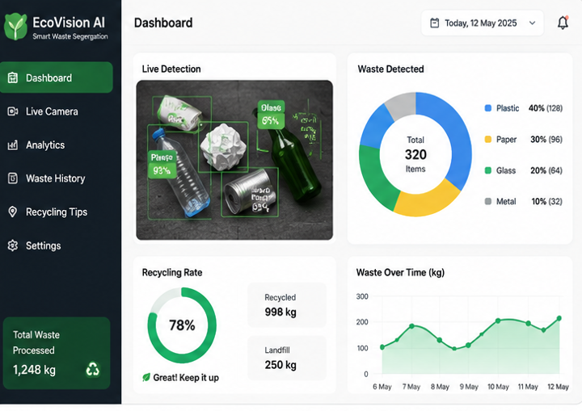
Capstone Project Ideas
AI for Environment & SDG 17
• EcoVision AI – Smart waste segregation using image recognition.
• GreenTrack – AI-powered carbon footprint tracker with personalized suggestions.
• EcoRoute AI – Suggests low-emission travel routes.
• Green Skill Connect – Recommends green courses, certifications and jobs.
• Smart Data Centre Optimizer – Uses AI to reduce power and cooling consumption.

